Slide 2

Web Component

Slide 3
Agenda
Web Component
Custom Element
Shadow DOM
Examples
Q&A

Slide 4
Web component
HTML Template
Custom Element
Shadow DOM
HTML Import

Slide 5
Custom Element
Define your HTML tag
Extend existing HTML tag
Less code, modular code, and more reuse

Slide 6
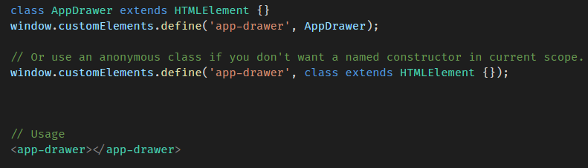
Custom Element - Define
A class extends HTMLElement
Tag naming must contain a dash (-).
Notes:
Custom elements can be used before their definition is registered.

Slide 7
Custom Element – lifecycle hooks
Name | Called when
Constructor | An instance of the element is created or upgraded
connectedCallback | Every time the element is inserted into the DOM.
disconnectedCallback | Every time the element is removed from the DOM.
attributeChangedCallback(attrName, oldVal, newVal) | An observed attribute has been added, removed, updated, or replaced.
adoptedCallback | The element has been moved into a new document.

Slide 8
Custom Element – props and attributes
Reflecting between DOM properties and HTML attributes
observedAttributes property
Less code, modular code, and more reuse

Slide 9
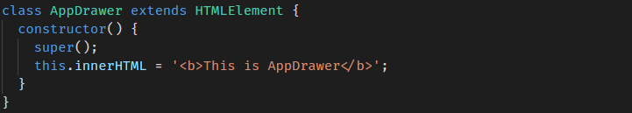
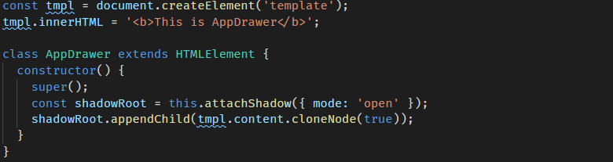
Custom Element - content
Using xxxHTML property
Using HTML template

Slide 10
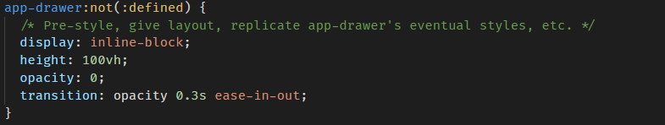
Custom Element – styling
Similar with defined HTML tag
Pre-styling unregistered element

Slide 11

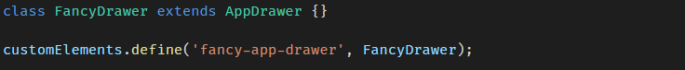
Custom Element – Extending
Native HTML element
Another custom element

Slide 12
Shadow dom
Isolated DOM
Scoped CSS
Composition
Simplifies CSS
Productivity

Slide 13
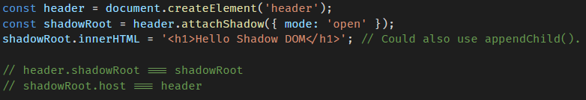
Shadow dom - creating
Element.attachShadow()
<slot> element
Render the user's markup over here

Slide 14
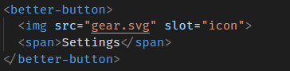
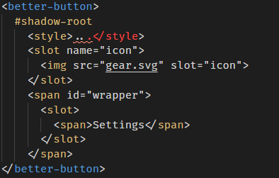
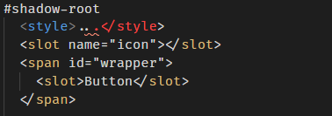
Shadow dom vs. light dom

Slide 15
Shadow dom - styling
CSS selectors used inside shadow DOM apply locally to your component.
Styling based on context
Styling distributed nodes
Styling a component from the outside

Slide 16
Shadow dom – Event model
Look like event comes from the host component.
Custom DOM event
Internal by default
compose property
delegatesFocus property

Slide 17
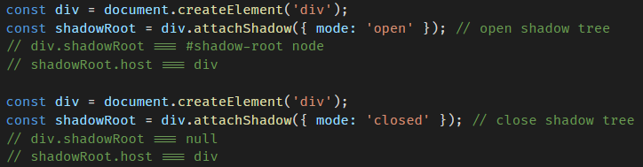
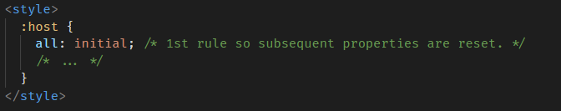
Shadow dom – More
Opened vs closed
Resetting inheritable styles

Slide 18
Examples
Checkbox
Card
Tab

Slide 19
Q&A

